Slide 1
Wireless Transmission
MIMO and OFDM

Slide 2
Wireless Transmission
Introduction to MIMO;
MIMO Channel Capacity and diversity gain;
Introduction to OFDM; MIMO-OFDM system;

Slide 3
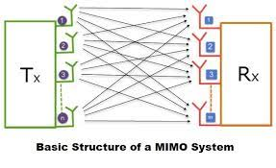
MIMO
Multiple-Input Multiple-Output (MIMO) is a wireless technology that uses multiple transmitters and receivers to transfer more data at the same time.
All wireless products with 802.11n support MIMO. The technology helps allow 802.11n to reach higher speeds than products without 802.11n.
an antenna technology for wireless communications in which multiple antennas are used at both the source (transmitter) and the destination (receiver).

Slide 4
MIMO characteristics
LTE uses MIMO and orthogonal frequency-division multiplexing (OFDM) to increase speeds up to 100 megabits per second (mbps) and beyond.
These rates are double what was offered in previous 802.11a Wi-Fi.
LTE uses MIMO for transmit diversity, spatial multiplexing (to transmit spatially separated independent channels), and single-user and multiuser systems.
These massive 5G MIMO systems use numerous small antennas to boost bandwidth to users -- not just transmission rates as with third-generation (3G) and 4G cellular technology -- and support more users per antenna.
Unlike 4G MIMO, which uses a frequency division duplex (FDD) system for supporting multiple devices,
5G massive MIMO uses a different setup called time division duplex (TDD). This offers numerous advantages over FDD (see image below).

Slide 5
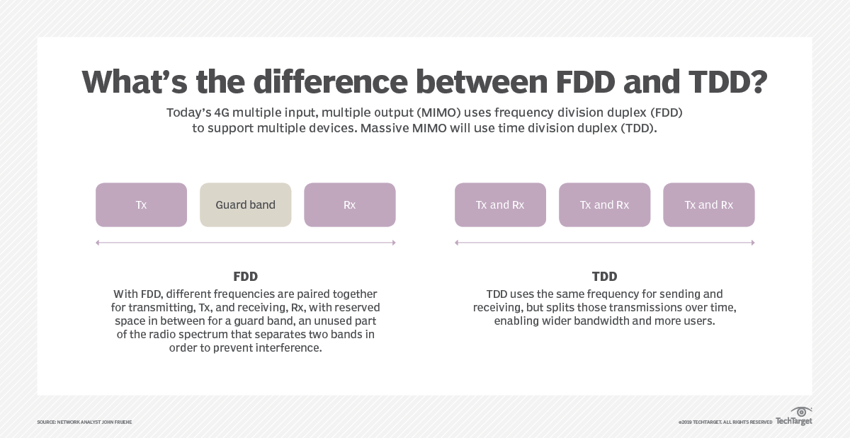
FDD VS TDD

Slide 6
MIMO Beamforming
Beamforming is an RF management technique that maximizes the signal power at the receiver by focusing broadcast data to specific users instead of a large area.
With 5G, three-dimensional (3D) beamforming forms and directs vertical and horizontal beams at the user.
These can reach devices even if they're at the top of a high-rise,
for example. The beams prevent interference with other wireless signals and stay with users as they move throughout a given area.

Slide 7
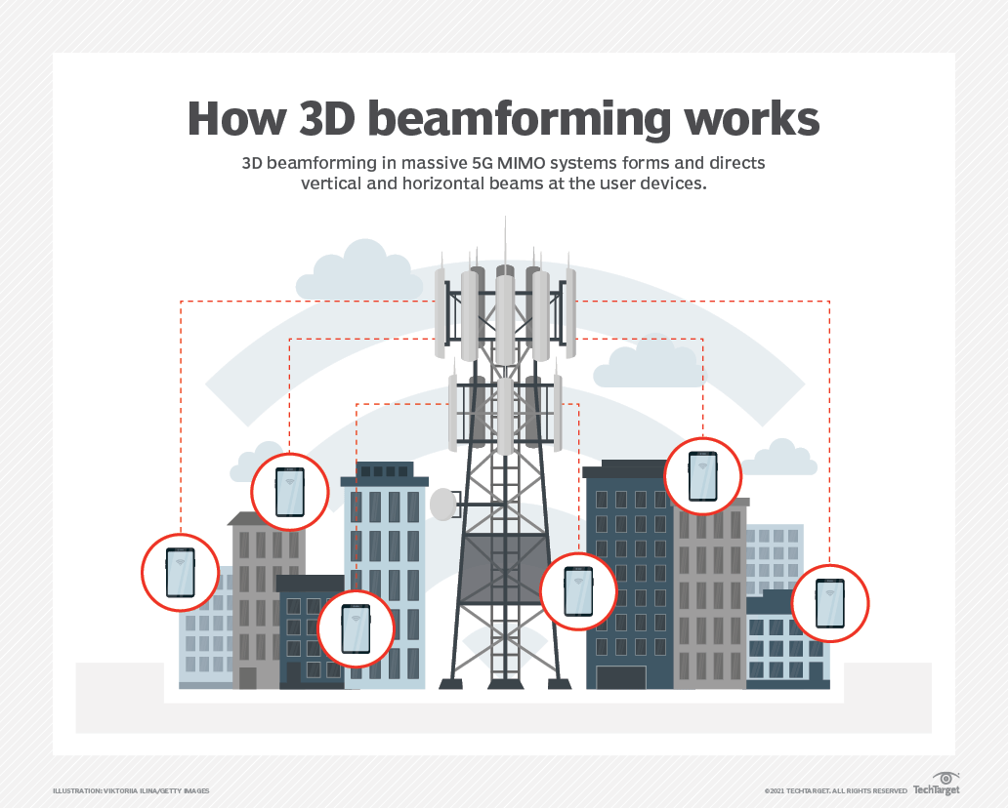
Beamforming in MIMO

Slide 8
Types of MIMO
There are two primary types of MIMO: single-user (SU) and multiuser (MU).
In SU-MIMO systems, data streams can only interact with one device on the network at a time. MU-MIMO systems, therefore, outperform SU-MIMO.
Issues arise with SU-MIMO when many users attempt to use the network simultaneously. If one person is uploading video and another is conferencing, the data stream will choke, causing latency, or delays, to skyrocket.
On the other end of the spectrum, MU-MIMO has the advantage of being able to stream multiple data sets to multiple devices at a time.

Slide 9
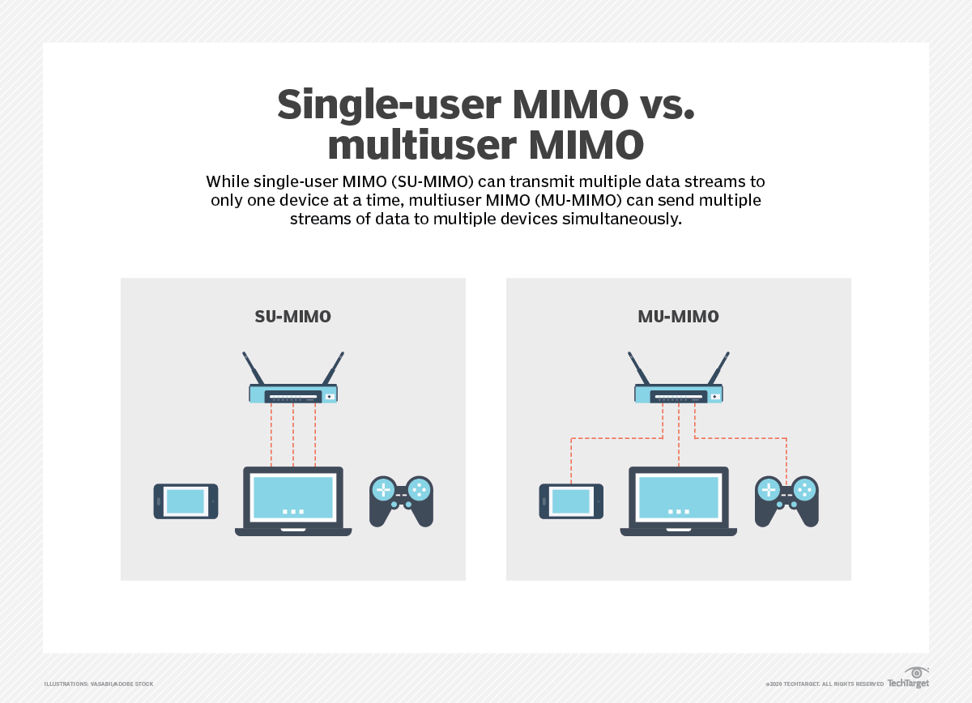
SU V/S MU MIMO

Slide 10
MIMO's primary advantages
MIMO enables stronger signals. It bounces and reflects signals so a user device doesn't need to be in a clear line of sight.
Video and other large-scale content can travel over a network in large quantities.
This content travels more quickly because MIMO supports greater throughput.
Many data streams improve visual and auditory quality. They also decrease the chance of lost data packets.

Slide 11
How massive MIMO systems are influencing the future
MIMO is a primary tool for advancing all aspects of wireless communications. It plays a substantial role in 5G technology
High network capacities. Data travels to more users through the deployment of 5G New Radio (5G NR). MU-MIMO and 5G NR enable more users to access data at the same frequency and time rates.
More coverage. Users can soon expect high-speed data wherever they are, even at the edge of service areas. Using 3D beamforming, the coverage adapts to the user's movement and location.
Better user experience (UX). Watching videos and uploading content is easier and faster. Massive MIMO and 5G technology transform UX.

Slide 12
MIMO Channel capacity
In fading, capacity with both transmitter and receiver knowledge is the average of the capacity for the static channel, with power allocated either by an instantaneous or average power constraint.
Under the instantaneous constraint power is optimally allocated over the spatial dimension only. Under the average constraint it is allocated over both space and time.
capacity grows linearly with the size of the antenna arrays.

Slide 13
MIMO Diversity Gain
Diversity gain is the decreased required receive SNR for a given bit error rate (BER) averaged over the fading.
This is the reduction in fading margin that's obtained by reducing the fading with the smart antenna.

Slide 14
OFDM- Orthogonal frequency-division multiplexing
method of data transmission where a single information stream is split among several closely spaced narrowband sub channel frequencies instead of a single Wideband channel frequency.
It is mostly used in wireless data transmission but may be employed in wired and fiber optic communication as well.
several bits can be sent in parallel, or at the same time, in separate substream channels.
This enables each substream's data rate to be lower than would be required by a single stream of similar bandwidth.
This makes the system less susceptible to interference and enables more efficient data bandwidth.

Slide 15
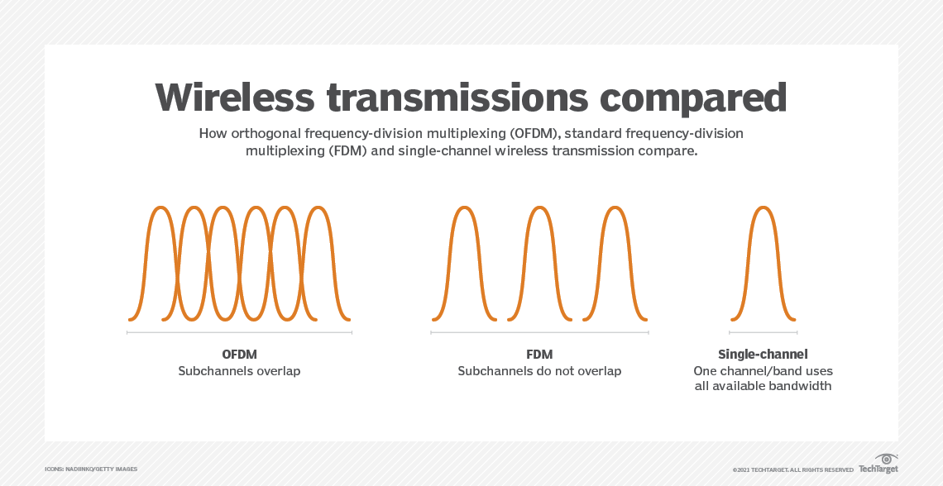
OFDM V/S FDM

Slide 16
Working of OFDM
In the traditional stream, each bit might be represented by a 1 nanosecond segment of the signal, with 0.25 ns spacing between bits, for example.
Using OFDM to split the signal across four component streams lets each bit be represented by 4 ns of the signal with 1 ns spacing between.
The overall data rate is the same, 4 bits every 5 ns, but the signal integrity is higher.

Slide 17
OFDM VS FDM
OFDM builds on simpler frequency-division multiplexing (FDM).
In FDM, the total data stream is divided into several subchannels, but the frequencies of the subchannels are spaced farther apart so they do not overlap or interfere.
With OFDM, the subchannel frequencies are close together and overlapping but are still orthogonal, or separate, in that they are carefully chosen and modulated so that the interference between the subchannels is canceled out.

Slide 18
Advantages
Primarily, OFDM is more resilient to electromagnetic interference, and it enables more efficient use of total available bandwidth because the subchannels are closely spaced. It is also more resistant to interference because several channels are available.
Advanced error correction can be used to spread out the overall data and compensate for small errors. So, narrowband interference on a single subchannel will not affect the other channels, enabling the overall system to still operate.
Frequency-selective interference fading due to multipath echo effects can also be corrected. The lower data rate on the individual subchannels enables guard intervals to be used between symbols, which eliminates intersymbol interference and helps with multipath errors.

Slide 19
Disadvantages of OFDM
OFDM systems must have closely tuned transmitters and receivers. This requires the timing on signal modulators and demodulators be closely matched and produced to tight tolerances.

Slide 20
Applications of OFDM
Digital radio, Digital Radio Mondiale, and digital audio broadcasting and satellite radio.
Digital television standards, Digital Video Broadcasting-Terrestrial/Handheld (DVB-T/H), DVB-Cable 2 (DVB-C2). OFDM is not used in the current U.S. digital television Advanced Television Systems Committee standard, but it is used in the future 4K/8K-capable ATSC 3.0 standard.
Wired data transmission, Asymmetric Digital Subscriber Line (ADSL), Institute of Electrical and Electronics Engineers (IEEE) 1901 powerline networking, cable internet providers. Fiber optic transmission may use either OFDM signals or several distinct frequencies as FDM.
Wireless LAN (WLAN) data transmission. All Wi-Fi systems use OFDM, including IEEE 802.11a/b/g/n/ac/ax. The addition of OFDMA to the Wi-Fi 6/802.11ax standard enables more devices to use the same base station simultaneously. OFDM is also used in metropolitan area network (MAN) IEEE 802.16 Worldwide Interoperability for Microwave Access (WiMAX>) installations.
Cellular data. Long-Term Evolution (LTE) and 4G cellphone networks use OFDM. It is also an integral part of 5G NR cellular deployments.

Slide 21
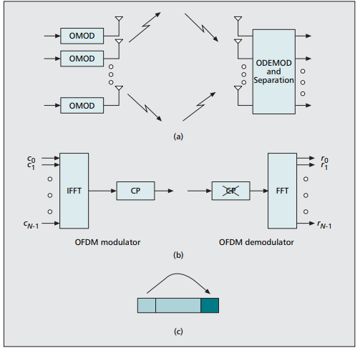
MIMO OFDM System
MIMO technology will predominantly be used in broadband systems that exhibit frequency-selective fading and, therefore, intersymbol interference (ISI).
OFDM modulation turns the frequency-selective channel into a set of parallel flat fading channels and is, hence, an attractive way of coping with ISI.
MIMO Wireless technology in combination with orthogonal frequency division multiplexing (MIMOOFDM) is an attractive air-interface solution for next-generation wireless local area networks (WLANs), wireless metropolitan area networks (WMANs), and fourth-generation mobile cellular wireless systems.

